Slide 1


Mini Project - Ecommerce Shopping Site
IGATE is now a part of Capgemini
Notes:
Copyright © 2011 IGATE Corporation (a part of Capegemini Group). All rights reserved.
No part of this publication shall be reproduced in any way, including but not limited to photocopy, photographic, magnetic, or other record, without the prior written permission of IGATE Corporation (a part of Capegemini Group).
IGATE Corporation (a part of Capegemini Group) considers information included in this document to be confidential and proprietary.

Slide 2

Team Members
Babu Pandi
Balaji .K
Chirag Mehta
Diksha Harariya
Dipali Mali
Dhana Raaj G S

Slide 3
Project Details
Project Title – E-commerce Shopping Site
Mentor Name - Sangeetha Chandrasekaran
Description - CyberShoppe is a web based application intended for online retailers. It would make searching, viewing and selection of a product easier for user’s specific to their needs.

Slide 4
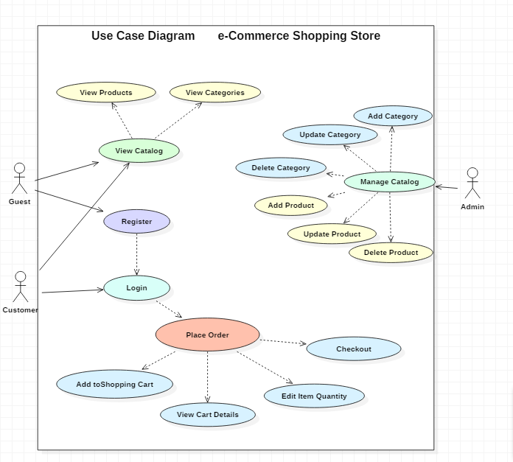
Use Case Diagram

Slide 5
Class Diagram

Slide 6
Activity Diagram(Admin)

Slide 7
Activity Diagram(User)

Slide 8
Sequence Diagram

Slide 9
Screen Shots

Slide 10
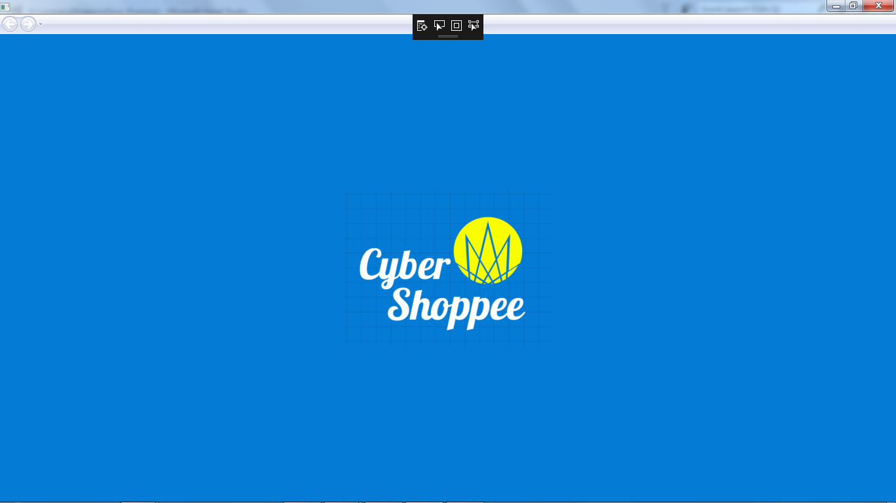
HomePage

Slide 11
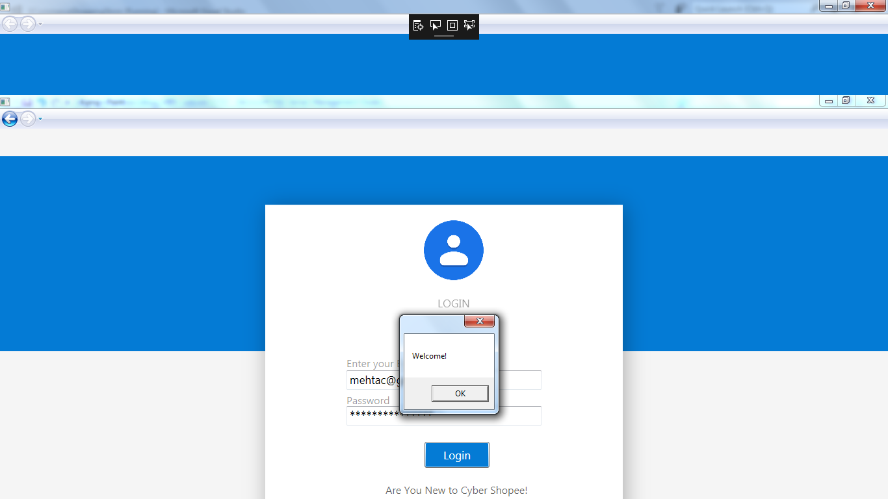
Login Page

Slide 12
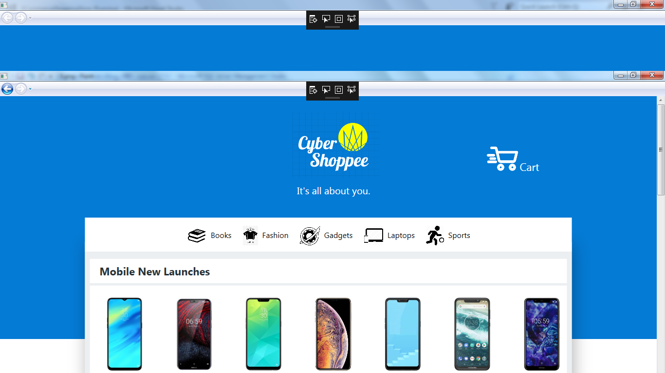
Categories Page

Slide 13
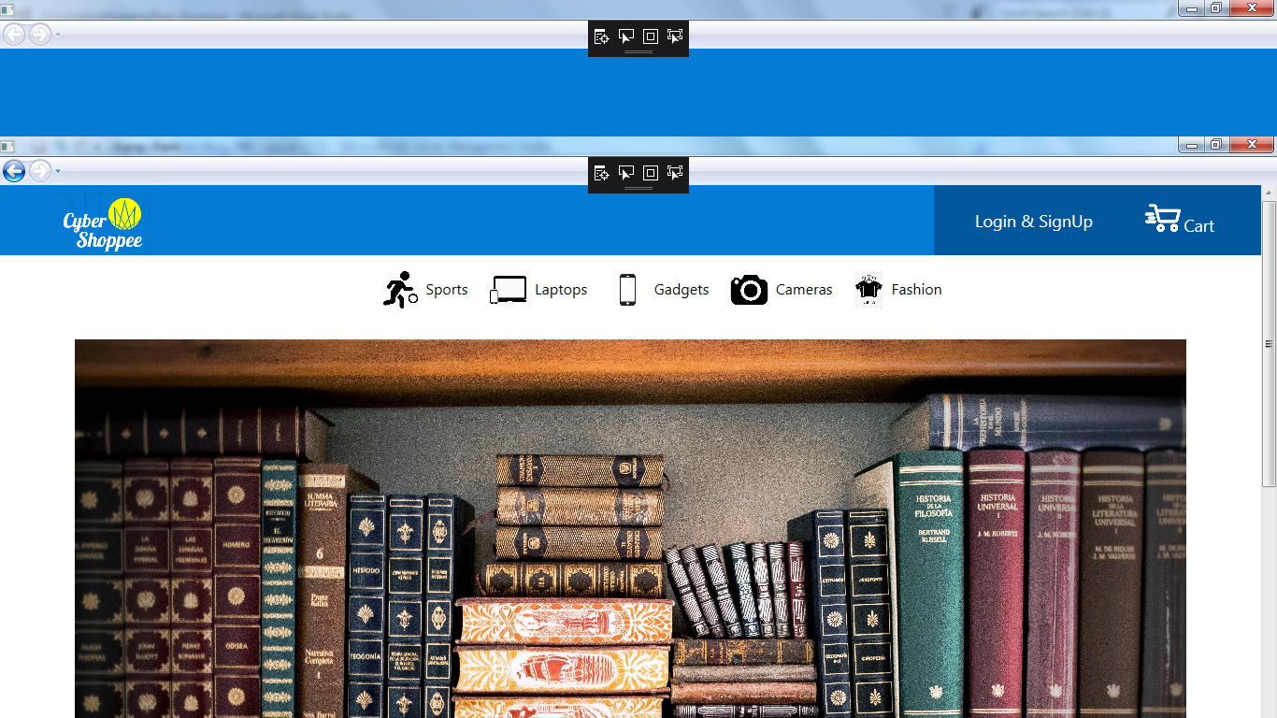
Products

Slide 14
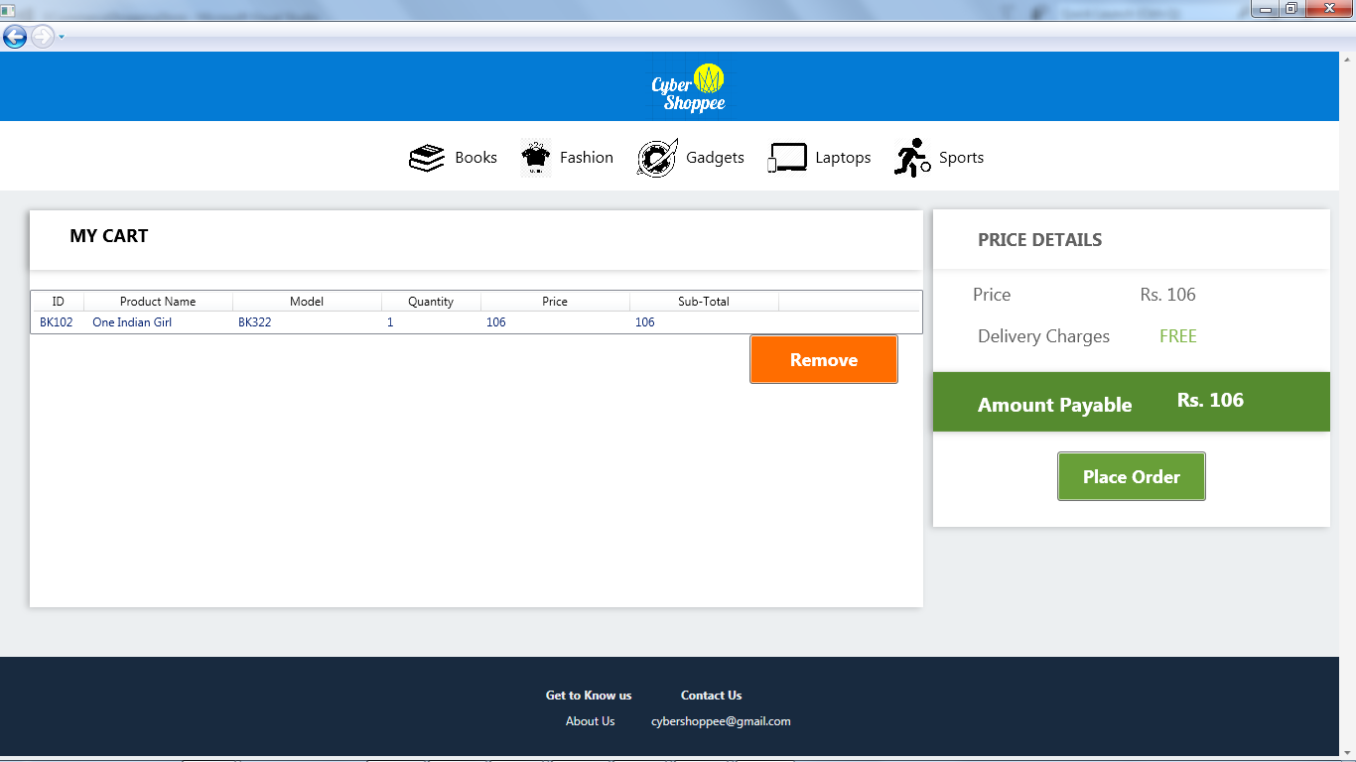
Shopping Cart

Slide 15
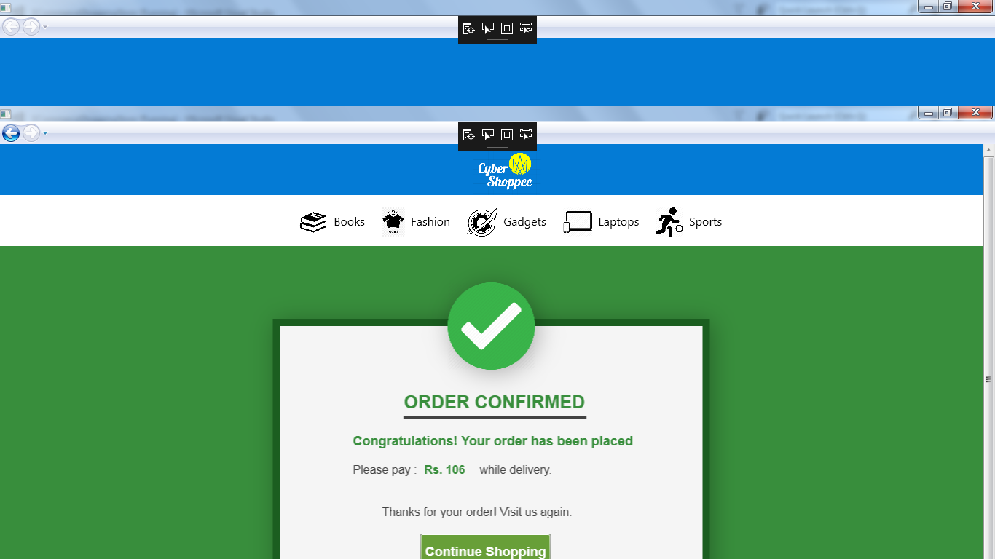
Order Confirmed Page

Slide 16
Future Enhancements
Adding more Payment Methods.
Adding more categories.
Adding more products.
Further simplifying the UI.
Adding provisions for discounts and coupons.

Slide 17
Thanks

